Slide 1
IMAGE RECOGNITION
using a machine learning model to identify different images

Slide 2
OUR PROJECT
TRAINING MODEL
How does it work?
IMAGE PROJECT
Training a model
Testing a model
Evaluation
Coding part
Results
Launching server

Slide 3
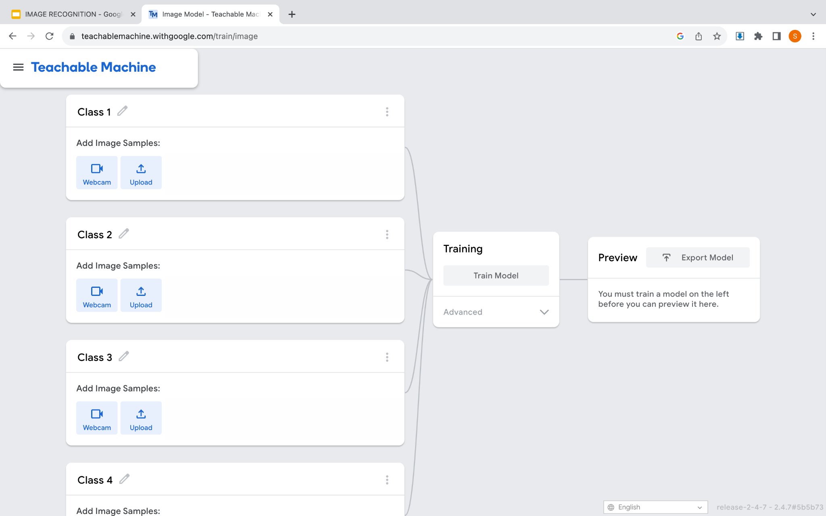
HOW DOES IT WORK?

Slide 4
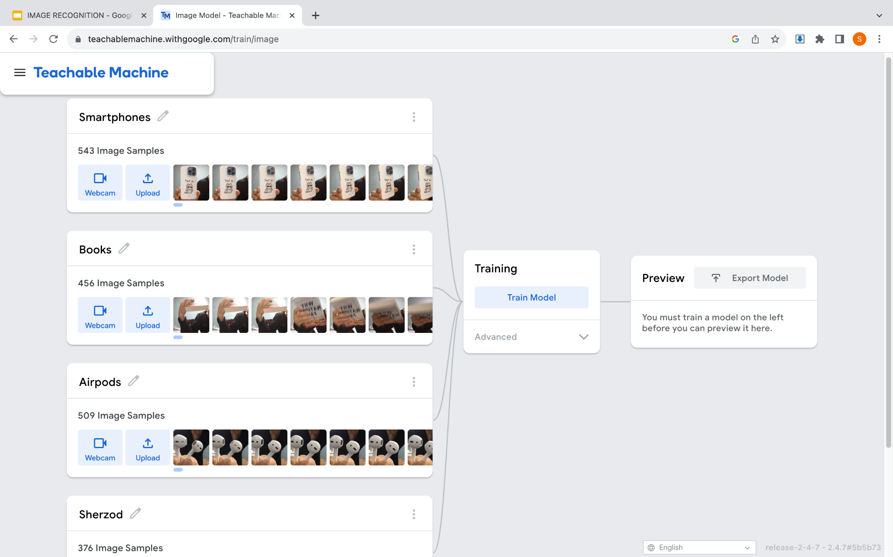
TRAINING A MODEL

Slide 5
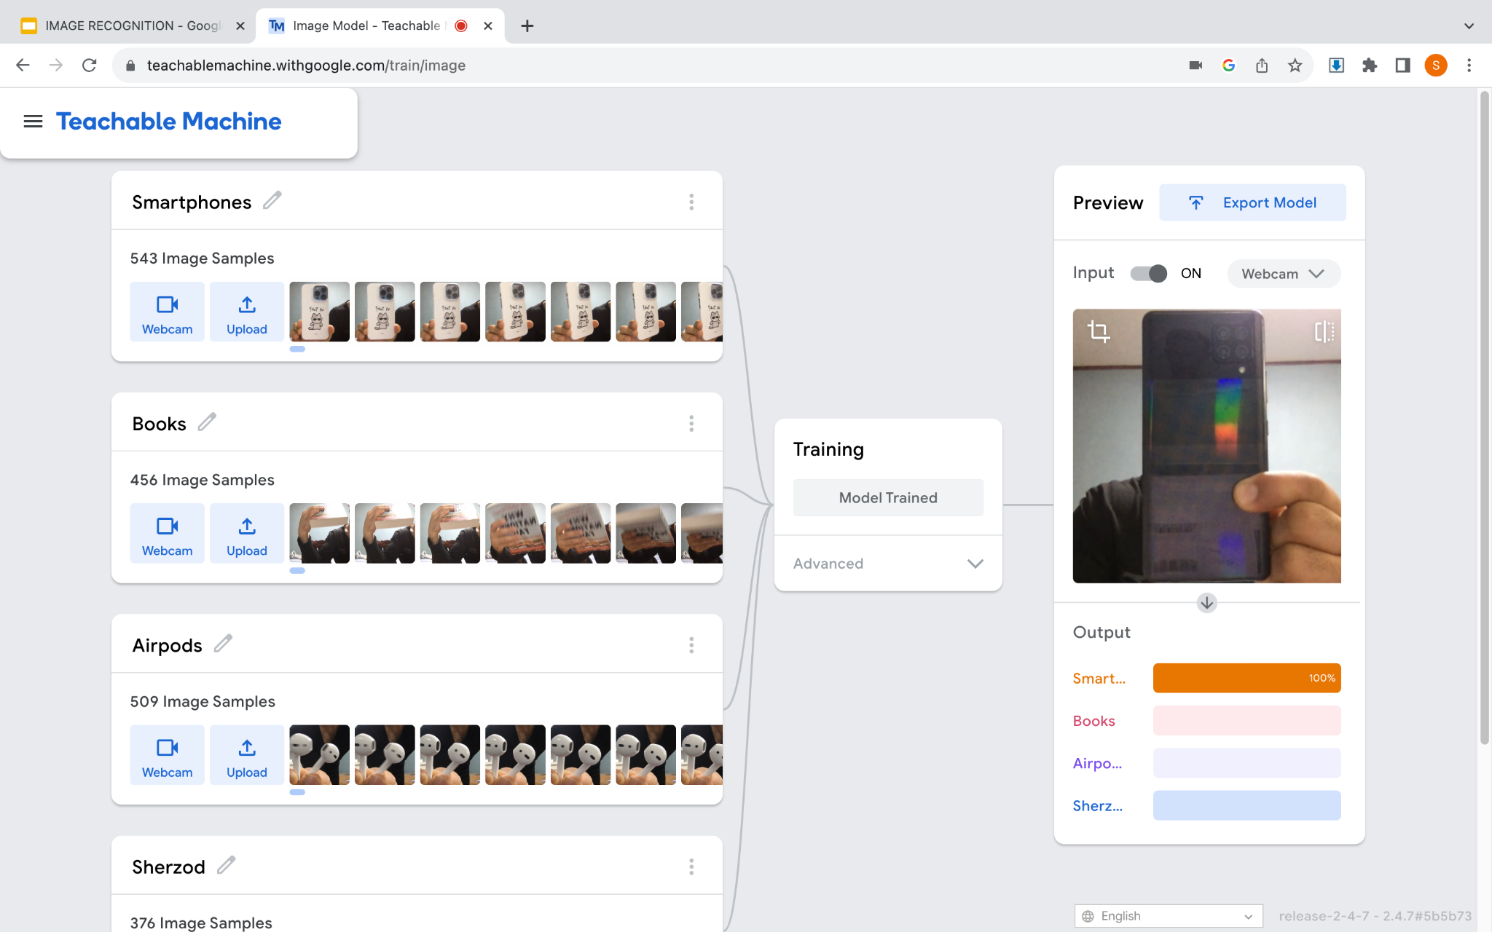
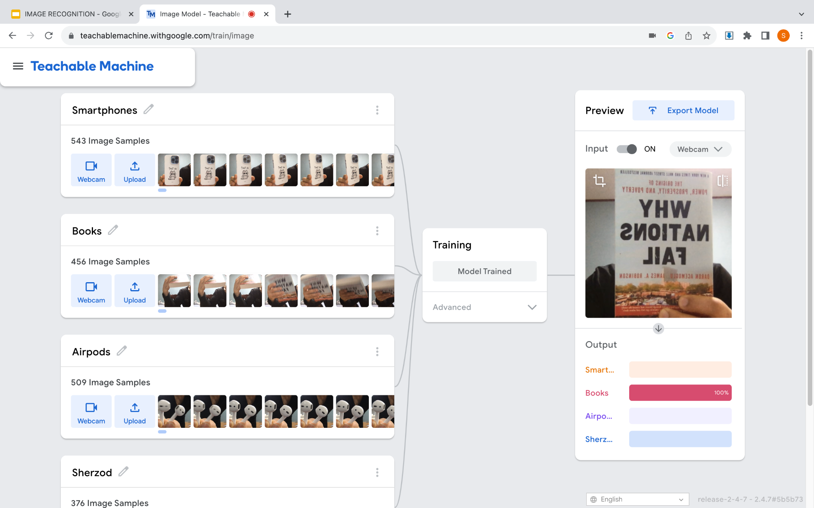
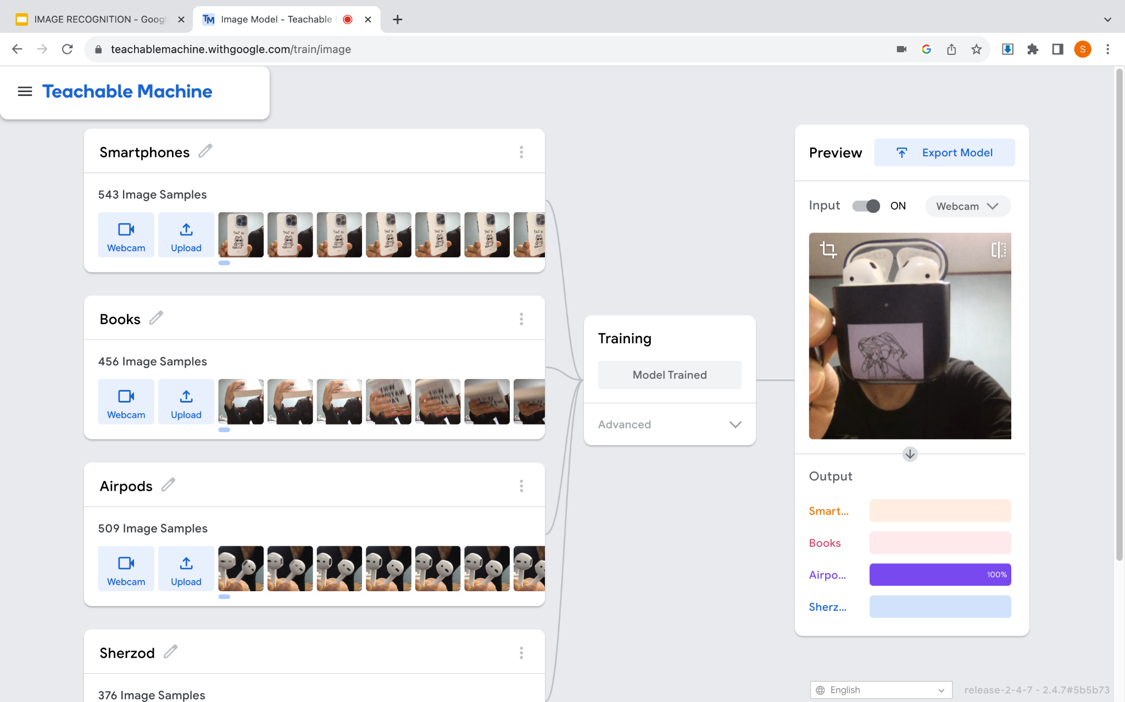
TESTING THE MODEL

Slide 6
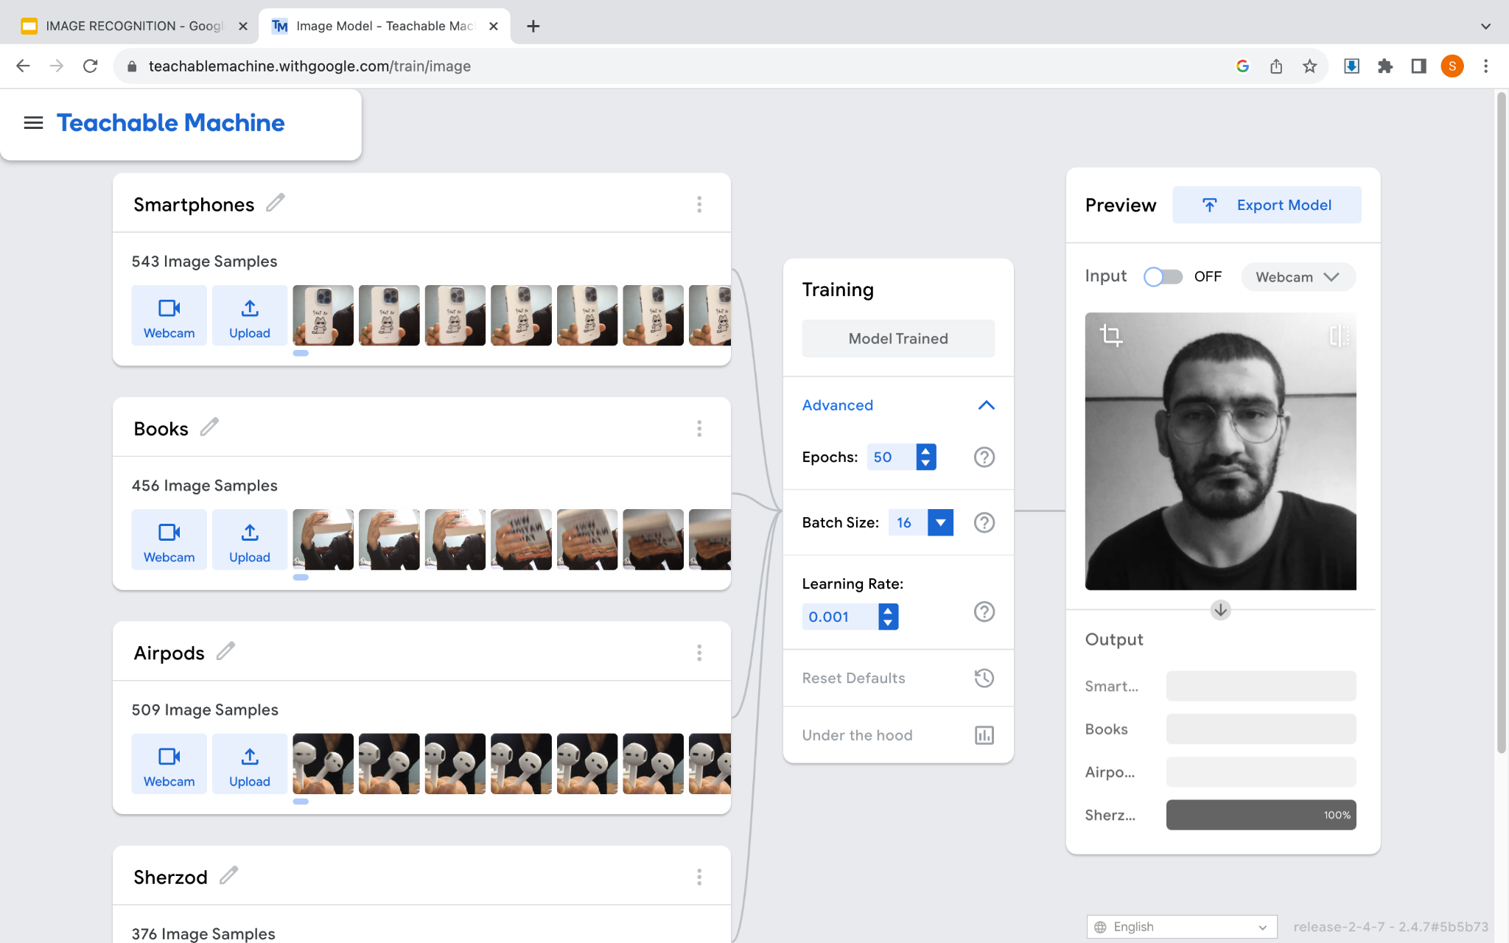
EVALUATION
Epochs: 50
Batch Size: 16
Learning Rate: 0.001
One epoch - model has been fed at least once

Slide 7
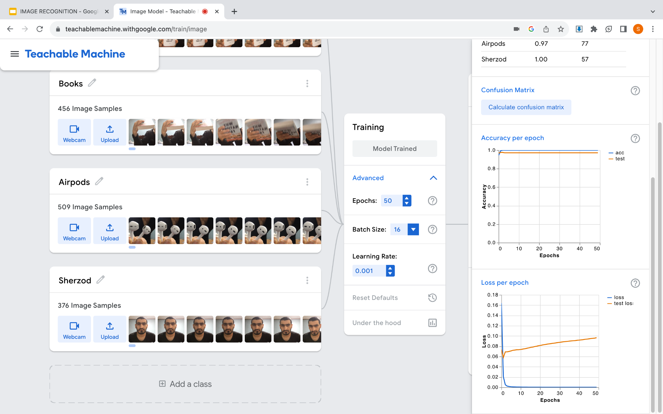
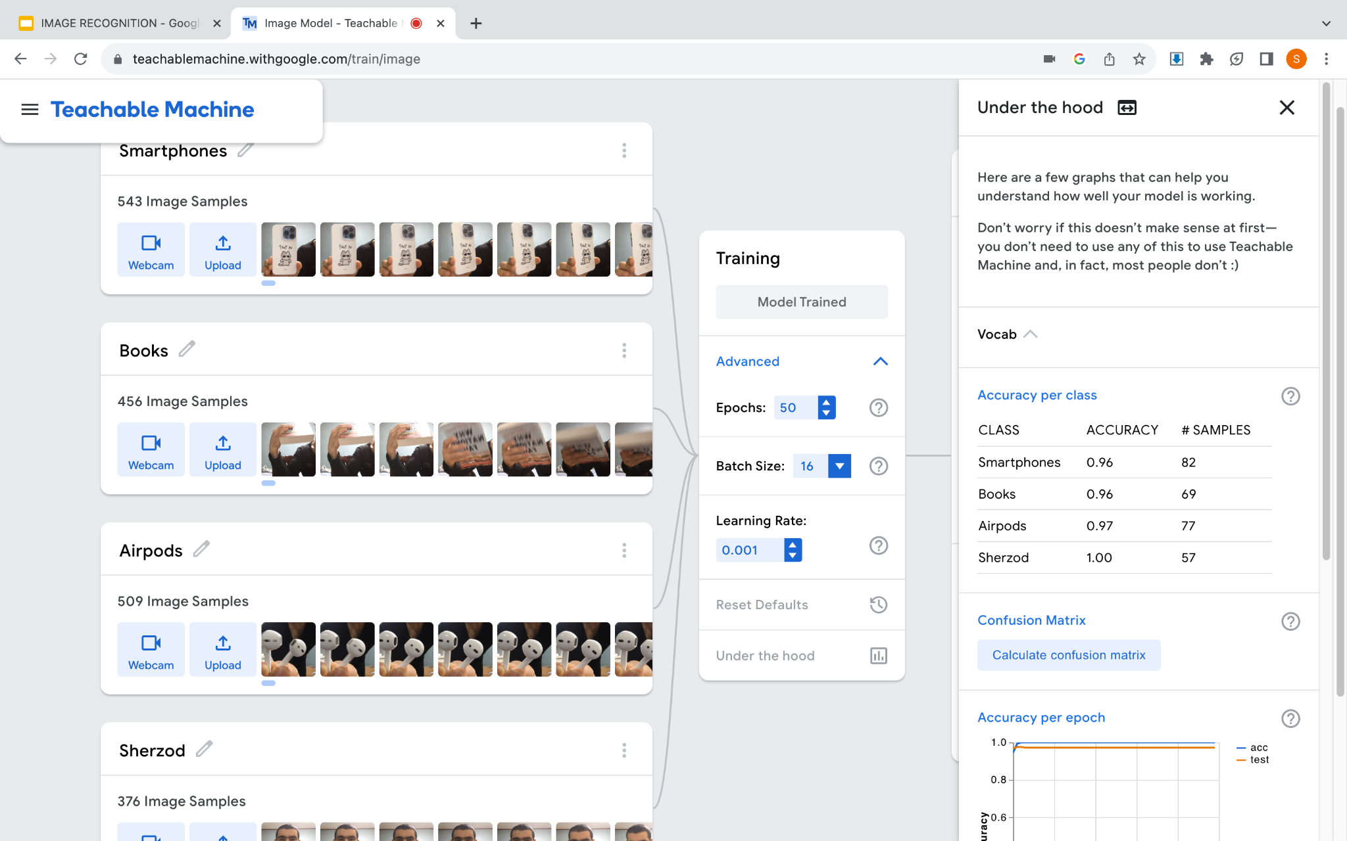
EVALUATION

Slide 8
EVALUATION

Slide 9
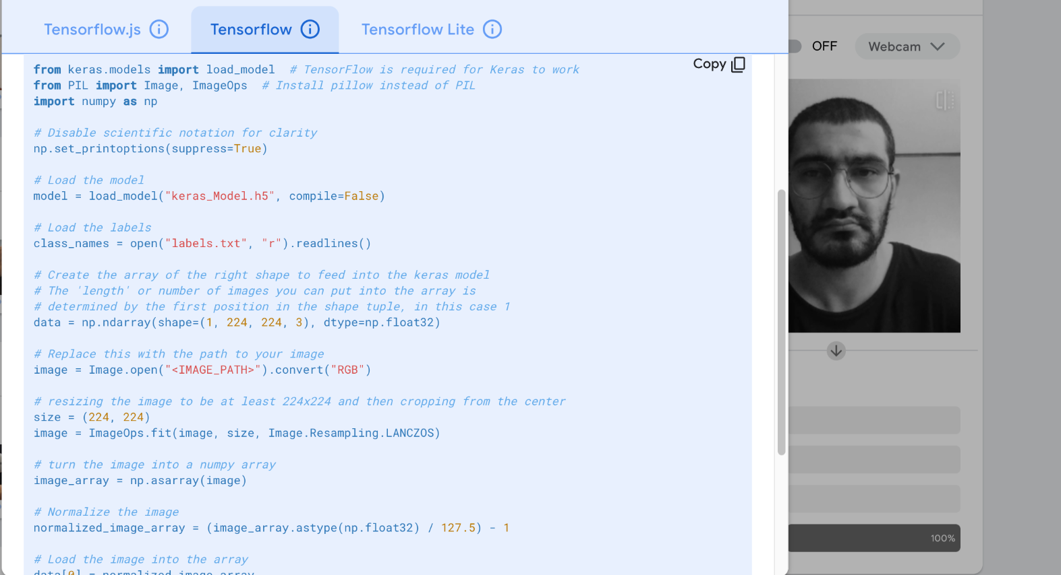
CODING PART

Slide 10

RESULTS

Slide 11

RESULTS

Slide 12

RESULTS

Slide 13

RESULTS

Slide 14
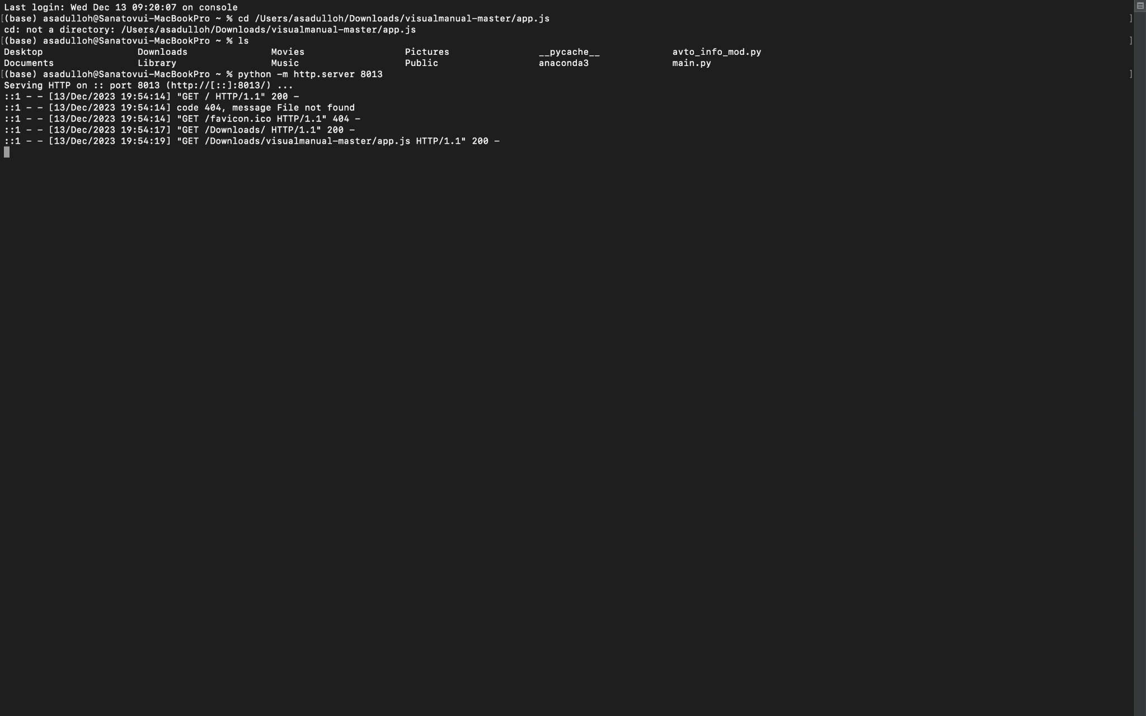
LAUNCHING SERVER

Slide 15
THANK YOU
THE END

